Slide 1
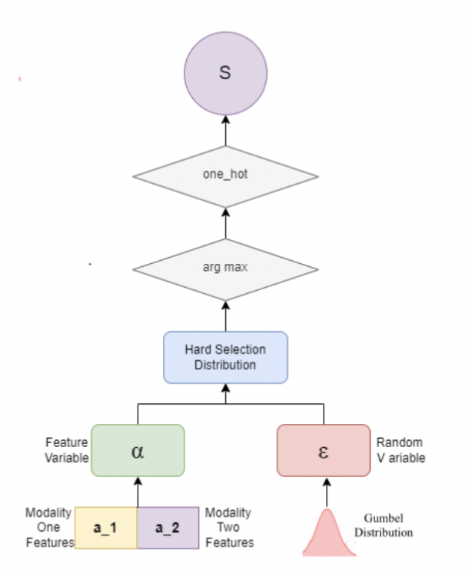
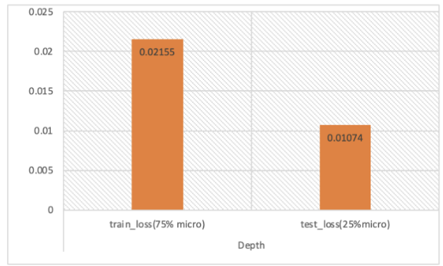
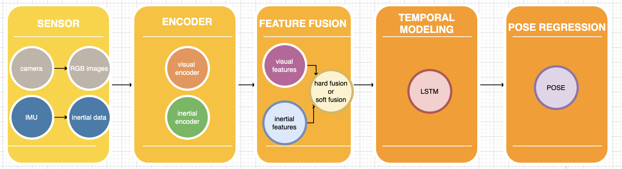
Pose Estimation for Micro Movement in Mixed Reality
Abstract
Mixed Reality (MR) is a technology that combines the real world with the virtual world to create an immersive user experience. Pose estimation is the process of determining the position and direction of an object in space. However, the current tracking technology is challenging for the tracking of small hand movements. To solve this problem, we propose a method to estimate the motion pose of the micro hand using selective sensor fusion. Our approach combines information from multiple sensors, such as cameras and inertial measurement units. We use real world hand motion data sets to evaluate our method and prove its effectiveness in tracking micro motion with high accuracy.
Background
Result
The modularization of VIO includes visual sensor and inertial sensor, visual encoder and inertial encoder, feature fusion, time modeling and pose regression. The model uses visual sensors and inertial sensors to obtain a series of original images, depth images and IMU measurements, uses visual encoders and inertial encoders for feature coding, uses a hard fusion method for sensor feature fusion, and generates the corresponding pose transformation.
For the model trained with macro movement data, when testing 25% of the macro movement data and 100% of the micro movement data, the test loss value of the micro movement is 0.0153. The total loss value of the train is 0.2155, while the total loss value of the test is 0.1074.
Hard Sensor Fusion
Conclusions
Hard fusion learns a stochastic function that generates a binary mask that either propagates the feature or blocks it.
We employed a more lightweight method – Gumbel-Softmax resampling to infer the stochastic layer to tackle the problem that stochastic layer cannot be trained directly by back-propagation and makes hard fusion can be trained in an end-to-end fashion.
Our work combines information from multiple sensors, which can provide a more accurate and comprehensive understanding of the movement being tracked. This can be particularly useful in situations where a single sensor may not be sufficient to accurately capture all of the relevant information. Future work is improving real-time performance and incorporating additional data sources.
All codes and data are stored in GitHub repository. The link is: https://github.com/Xiaohei-dsy/697SD-Project
Order online at https://www.postersession.com/order/

